Slide 1

Logistic Regression

Slide 2
Contents
Introduction
Logistic Function (Sigmoid)
Equation
Training Logistic Regression
Decision Boundary
Regularization in Logistic Regression

Slide 3
Introduction
Logistic Regression for Binary Classification
  Logistic Regression is particularly suited for situations where the dependent variable (the one we're trying to predict) is categorical and has two possible outcomes (binary).
  It's used to model the probability that a data point belongs to a particular class given its features.

Slide 4
Introduction
Estimating Probability for Classification
In Logistic Regression, the algorithm transforms the output of a linear equation using the logistic function (also known as the sigmoid function).
This transformation ensures that the output stays within the range of 0 and 1, which can be interpreted as a probability.
The sigmoid function maps any input to a value between 0 and 1, making it suitable for probability estimation.

Slide 5
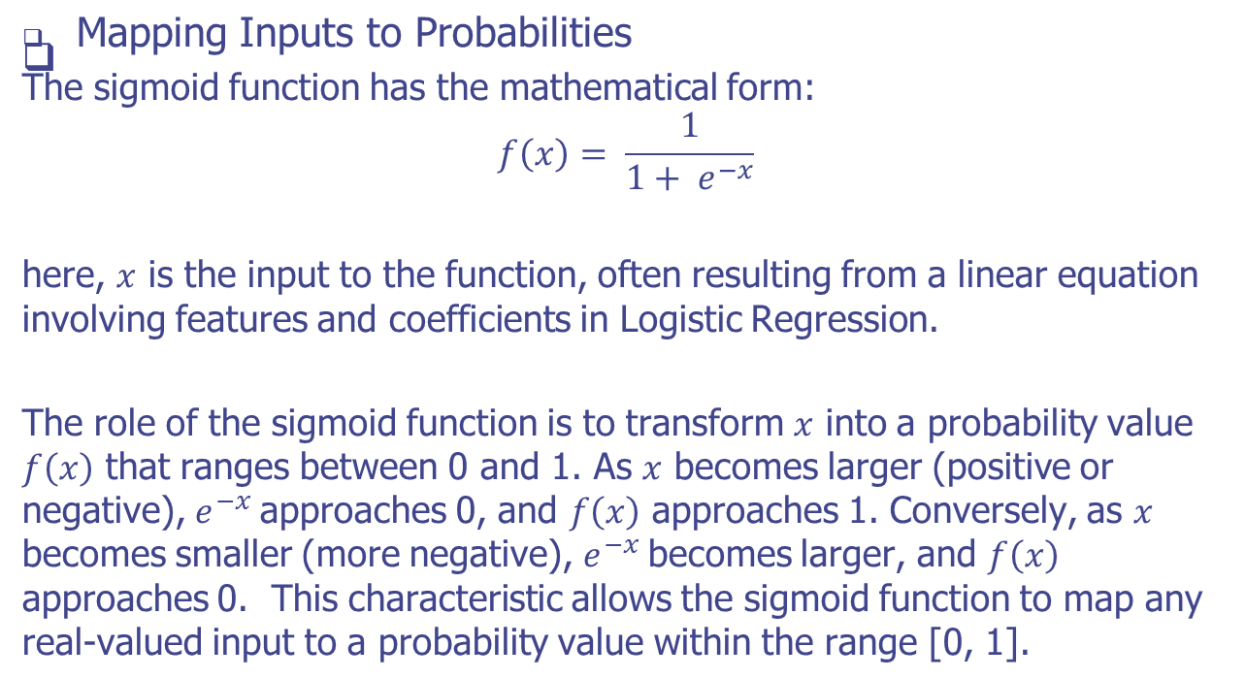
Logistic Function (Sigmoid)

Slide 6
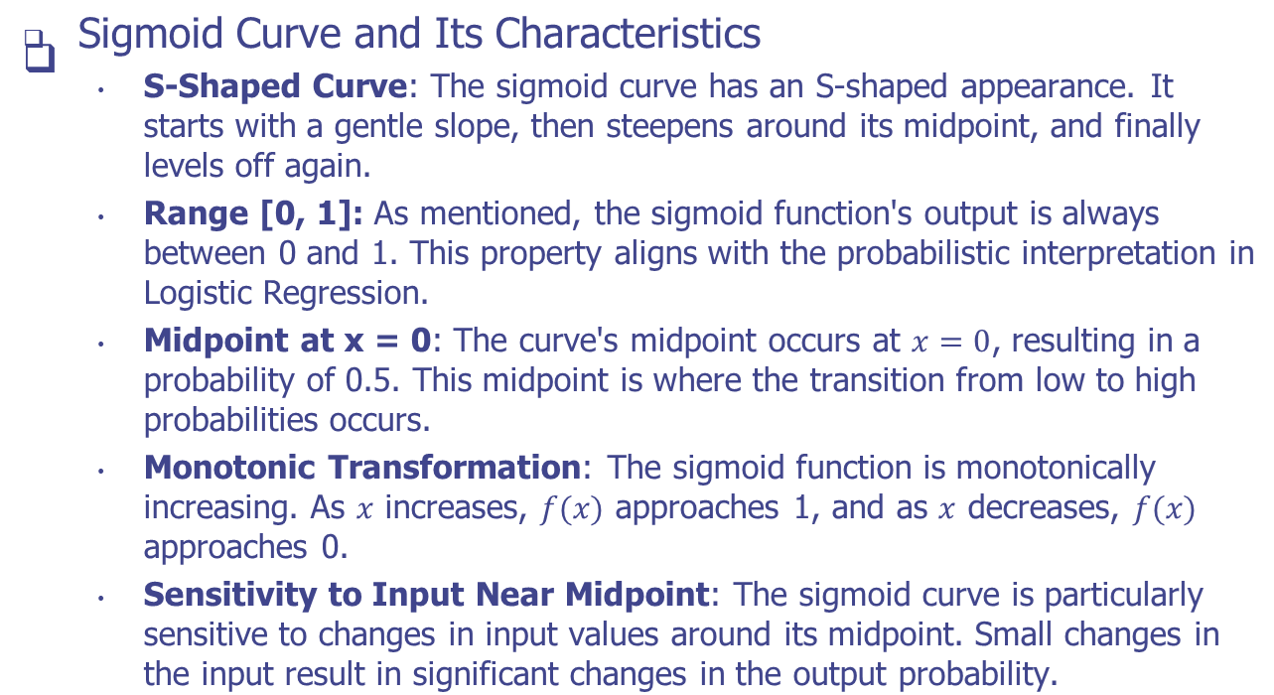
Logistic Function (Sigmoid)

Slide 7
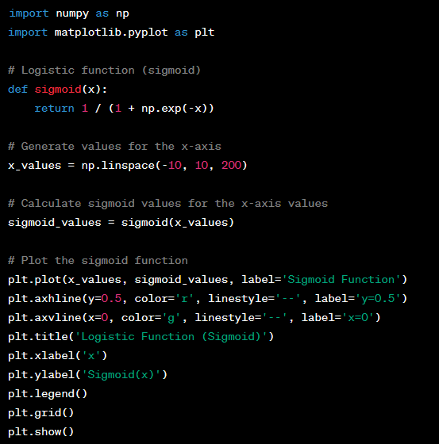
Example
In this example:
The sigmoid function defines the logistic function (sigmoid) as 1 / (1 + exp(-x)).
We generate values for the x-axis using the linspace function.
The sigmoid values for the x-axis values are calculated using the sigmoid function.
We use the matplotlib library to plot the sigmoid function along with reference lines for y=0.5 and x=0.

Slide 8
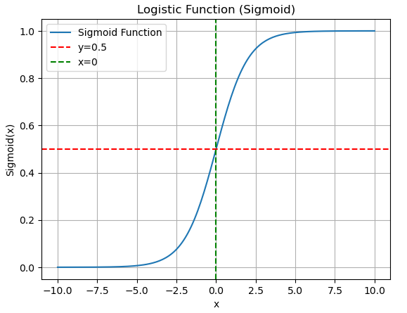
Example
In this example:
The sigmoid function defines the logistic function (sigmoid) as 1 / (1 + exp(-x)).
We generate values for the x-axis using the linspace function.
The sigmoid values for the x-axis values are calculated using the sigmoid function.
We use the matplotlib library to plot the sigmoid function along with reference lines for y=0.5 and x=0.

Slide 9
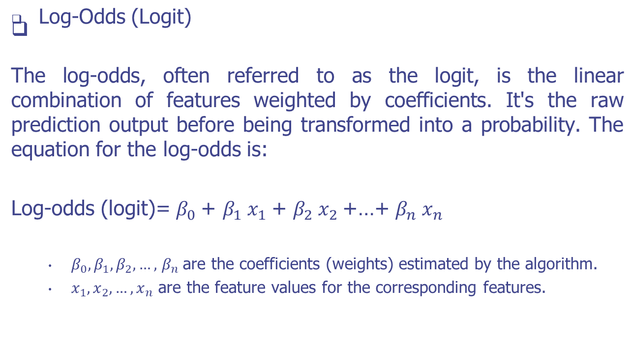
Logistic Regression Equation

Slide 10
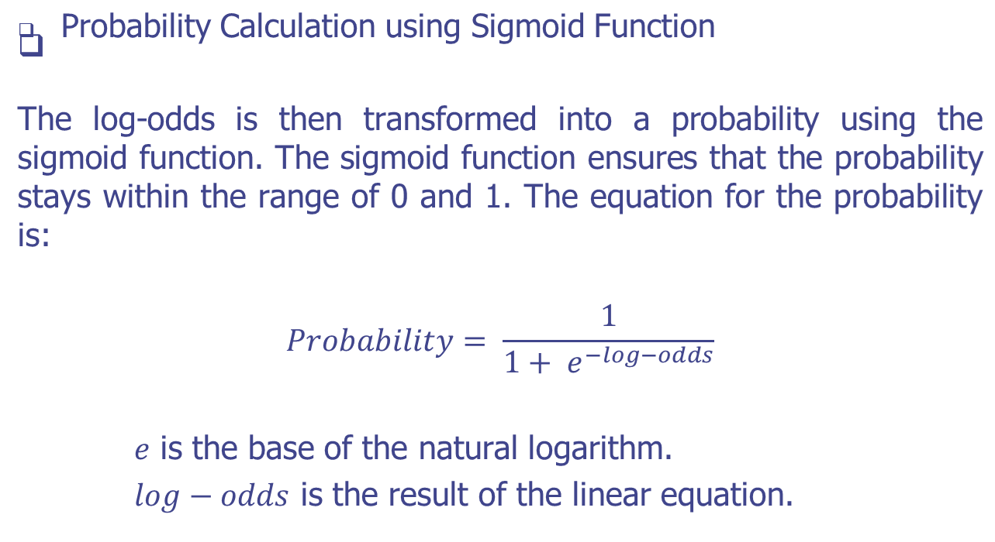
Logistic Regression Equation

Slide 11
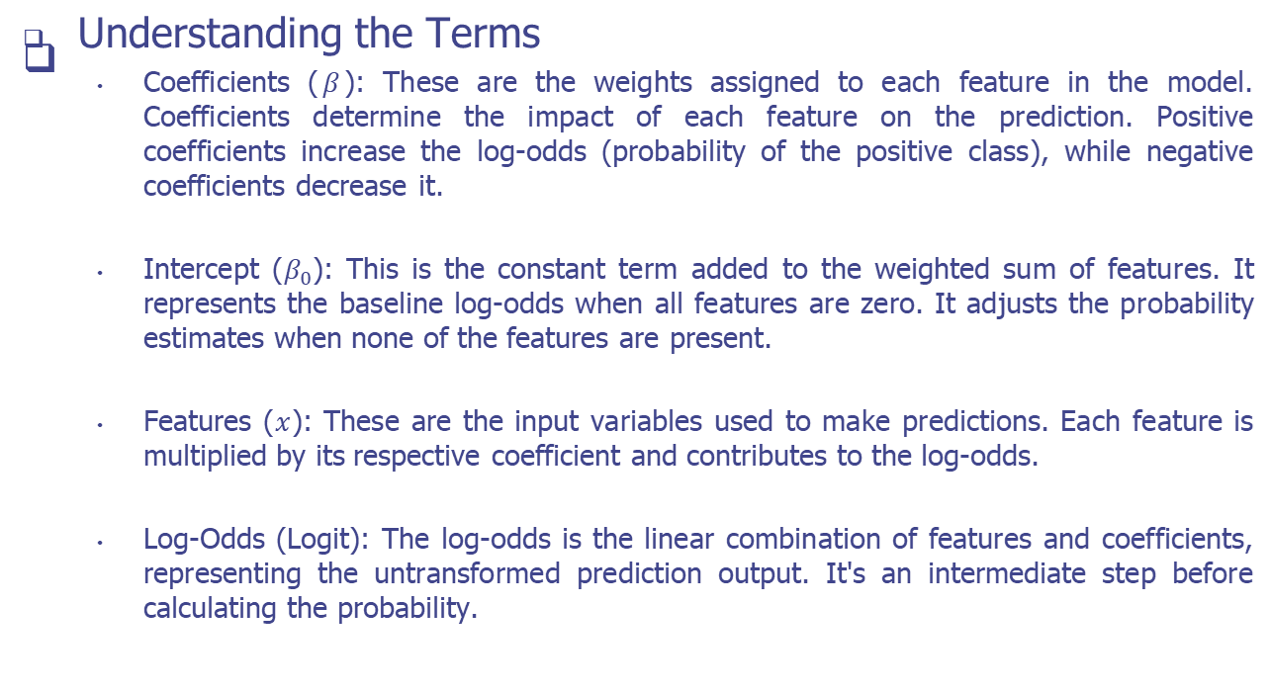
Logistic Regression Equation

Slide 12
Training
Initializing Coefficients
Calculating Log-Odds
Applying the Sigmoid Function for Probabilities
Minimizing the Loss (Optimizing Coefficients)
Convergence and Model Output

Slide 13
Training
Initializing Coefficients
  Start by initializing the coefficients (β0,β1,…,βnβ0​,β1​,…,βn​) with small random values or zeros.
Calculating Log-Odds
Applying the Sigmoid Function for Probabilities
Minimizing the Loss (Optimizing Coefficients)
Convergence and Model Output

Slide 14
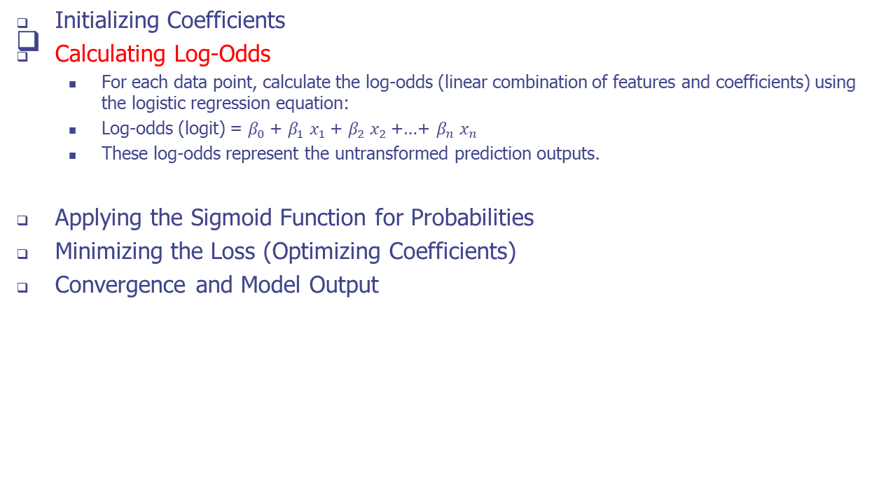
Training

Slide 15
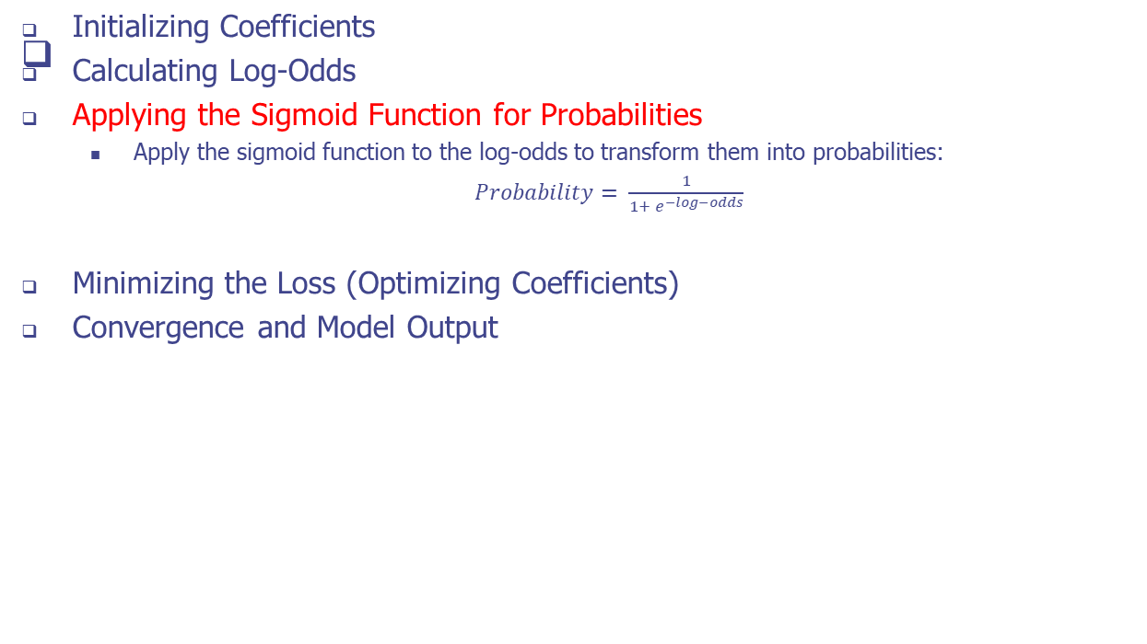
Training

Slide 16
Training
Initializing Coefficients
Calculating Log-Odds
Applying the Sigmoid Function for Probabilities
Minimizing the Loss (Optimizing Coefficients)
  The goal is to minimize a loss function that quantifies the difference between predicted probabilities and actual labels.
  Common loss functions for logistic regression include the binary cross-entropy loss (log loss).
  Use optimization techniques like gradient descent to adjust coefficients and find the values that minimize the loss.
  Gradient Descent
Convergence and Model Output

Slide 17
Training
Initializing Coefficients
Calculating Log-Odds
Applying the Sigmoid Function for Probabilities
Minimizing the Loss (Optimizing Coefficients)
Convergence and Model Output
  After convergence, we have optimized coefficients that provide accurate predictions.
  The model can now classify new data points by calculating log-odds, applying the sigmoid function for probabilities, and making a decision based on a threshold.

Slide 18
Decision Boundary
In logistic regression, the decision boundary is a critical concept that defines the separation between two classes in a binary classification problem.
It's a hyperplane (for higher-dimensional data) that separates the feature space into regions corresponding to the different classes.
The decision boundary is determined by the model's coefficients and intercept, and it plays a key role in making classification predictions.

Slide 19
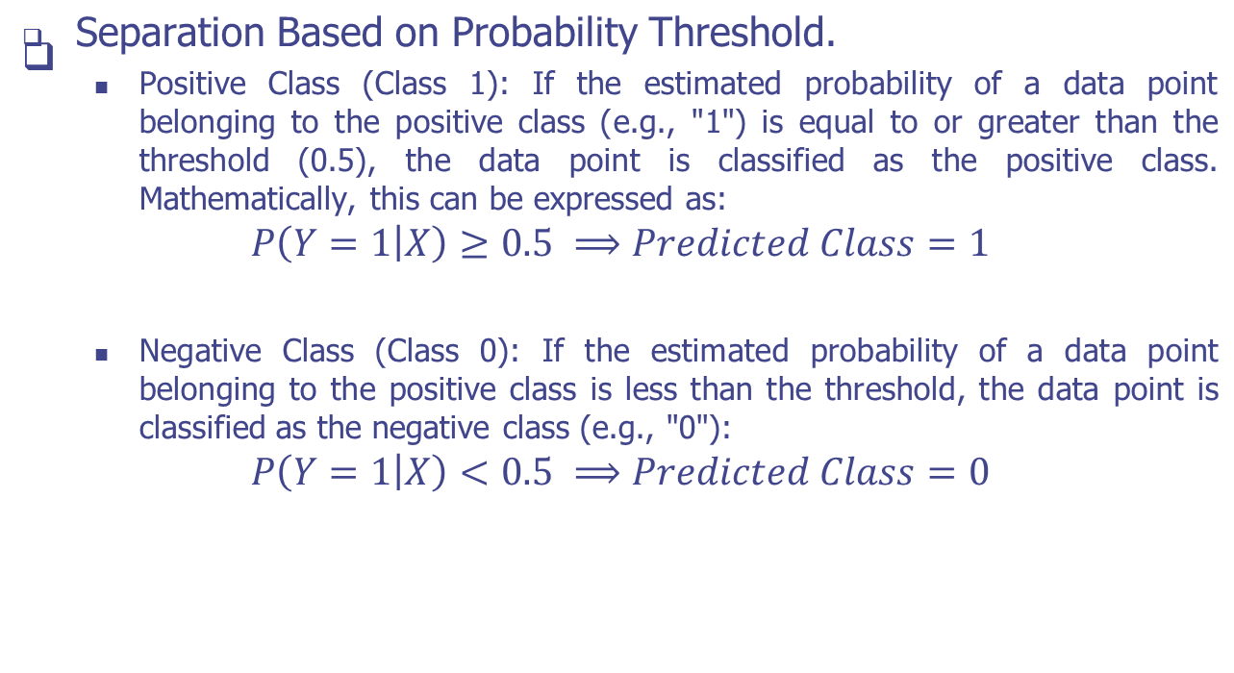
Decision Boundary

Slide 20
Decision Boundary
Visualizing the Decision Boundary.
  In a two-dimensional feature space (two features), the decision boundary is a line. In a three-dimensional space (three features), it's a plane.
  In higher-dimensional spaces, it's a hyperplane.
  The orientation and position of the decision boundary are determined by the coefficients and intercept of the logistic regression model.

Slide 21
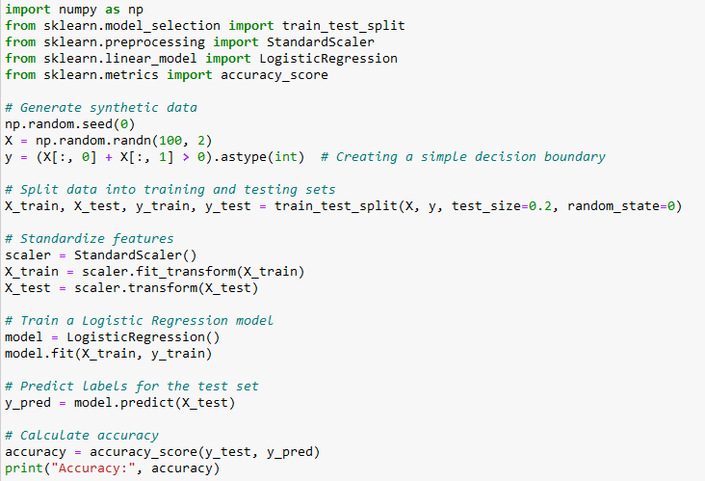
Example
In this example:
We generate synthetic data where the target labels are determined by a simple decision boundary (X[:, 0] + X[:, 1] > 0).
The data is split into training and testing sets using train_test_split.
Features are standardized using StandardScaler to ensure consistent scaling.
A Logistic Regression model is trained on the training data using the LogisticRegression class.
The model predicts labels for the test data.
The accuracy of the model is calculated using accuracy_score.

Slide 22
Regularization
Regularization is a technique used in logistic regression (and other machine learning algorithms) to prevent overfitting, which occurs when a model fits the training data too closely and performs poorly on new, unseen data.
Regularization introduces a penalty term to the model's objective function, encouraging it to achieve a balance between fitting the data and keeping the model's parameters (coefficients) small.

Slide 23
Regularization
Preventing Overfitting with Regularization
  Overfitting occurs when a model captures noise and fluctuations in the training data, leading to poor generalization on new data.
  Regularization helps prevent this by discouraging large values of coefficients, making the model less sensitive to variations in the training data.

Slide 24
Regularization
L1 and L2 Regularization
  L1 Regularization (Lasso):
    L1 regularization adds the absolute values of coefficients as the penalty term to the loss function.
    It encourages some coefficients to become exactly zero, effectively performing feature selection by eliminating less relevant features.
    L1 regularization tends to yield sparse solutions where only a subset of features have non-zero coefficients.
  L2 Regularization (Ridge):
    L2 regularization adds the squared values of coefficients as the penalty term to the loss function.
    It doesn't force coefficients to become exactly zero, but it significantly reduces their magnitudes.
    L2 regularization often results in more evenly distributed non-zero coefficients.

Slide 25
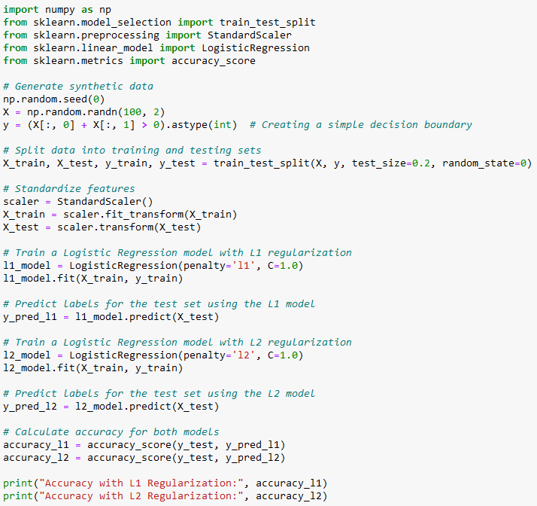
Example
In this example:
We generate synthetic data where the target labels are determined by a simple decision boundary (X[:, 0] + X[:, 1] > 0).
The data is split into training and testing sets using train_test_split.
Features are standardized using StandardScaler.
We train two Logistic Regression models, one with L1 regularization (penalty='l1') and one with L2 regularization (penalty='l2’).

Slide 26
Practice
Instructions
  Create a Python program that performs binary classification using Logistic Regression.
  You'll work with a dataset containing two classes of data points.
  Your task is to train a Logistic Regression model to classify the data points into the two classes.
Dataset
  class_1 = [ [2.0, 3.0], [3.5, 2.5], [1.5, 2.8], [4.0, 2.0], [3.6, 3.0]]
  class_2 = [ [7.0, 7.0], [8.0, 5.5], [6.5, 6.0], [9.0, 6.5], [8.2, 6.8]]
  test_data = [ [2.8, 2.5], [7.5, 6.2], [5.0, 4.5], [3.5, 3.8]]
  test_labels = [0, 1, 0, 0] # Corresponding labels for the test data

Slide 27
Practice
Tasks
  Task 1: Train Logistic Regression Model
    Write a function train_logistic_regression(X, y) that takes the training data X and labels y as input and trains a Logistic Regression model.
  Task 2: Predict Labels
    Write a function predict_labels(model, X) that takes the trained model and test data X as input and predicts the labels for the test data.
  Task 3: Evaluate the Model
    Write a function evaluate_model(predictions, true_labels) that takes the predicted labels and true labels as input and calculates the accuracy of the model.
  Task 4: Test Your Functions
    Apply each function to the provided dataset and evaluate the model's performance using the test data and labels.

Slide 28
Q & A

